Slide 1
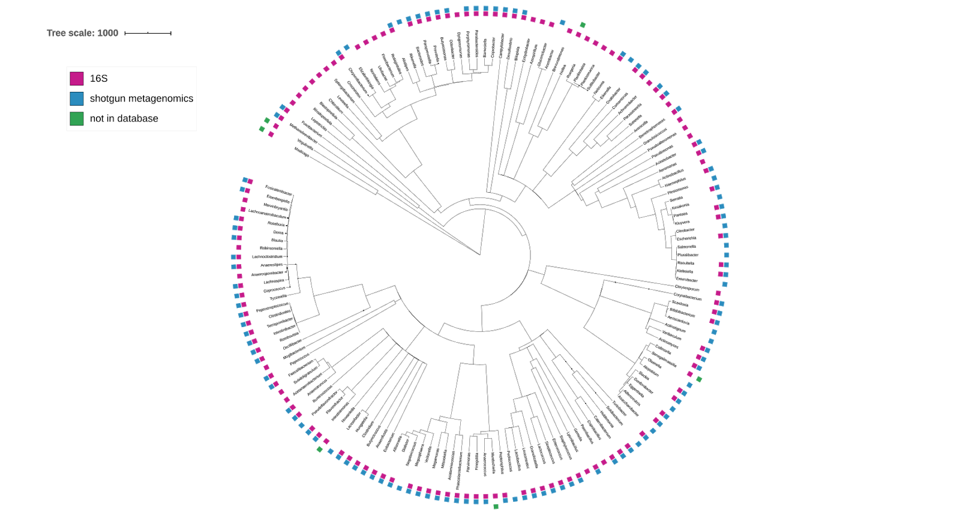
Family
Genus
Species
A
B

